Slide 1
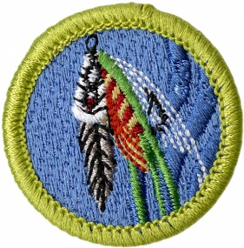
Fly Fishing Merit Badge
Troop 344/9344
Pemberville, OH

Slide 2
Requirements
Do the following:
Explain to your counselor the most likely hazards you may encounter while participating in fly-fishing activities and what you should do to anticipate, help prevent, mitigate, and respond to these hazards. Name and explain five safety practices you should always follow while fly-fishing.
Discuss the prevention of and treatment for health concerns that could occur while fly-fishing, including cuts and scratches, puncture wounds, insect bites, hypothermia, dehydration, heat exhaustion, heatstroke, and sunburn.
Explain how to remove a hook that has lodged in your arm.
Demonstrate how to match a fly rod, line and leader to achieve a balanced system. Discuss several types of fly lines, and explain how and when each would be used. Review with your counselor how to care for this equipment.

Slide 3
Requirements
Demonstrate how to tie proper knots to prepare a fly rod for fishing:
Tie backing to the arbor of a fly reel spool using an arbor knot.
Tie backing to the fly line using a nail (tube) knot.
Attach a leader to the fly line using nail (tube) knot or a loop-to-loop connection.
Add a tippet to a leader using a surgeon's knot or a loop-to-loop connection,
Tie a fly onto the terminal end of the leader using an improved clinch knot.
Explain how and when each of the following types of flies is used: dry flies, wet flies, nymphs, streamers, bass bugs, poppers , and saltwater flies. Tell what each one imitates. Tie at least two types of the flies mentioned in this requirement.
Demonstrate the ability to cast a fly 30 feet consistently and accurately using both overhead and roll cast techniques.

Slide 4
Requirements
Go to a suitable fishing location and what fish may be eating both above and beneath the water's surface. Look for flying insects and some that may be on or beneath the water's surface. Explain the importance of matching the hatch.
Do the following:
Explain the importance of practicing Leave No Trace techniques. Discuss the positive effects of Leave No Trace on fishing resources.
Discuss the meaning and importance of catch and release. Describe how to properly release a fish safely to the water.
Obtain and review a copy of the regulations affecting game fishing where you live or where you pan to fish. Explain why they were adopted and what is accomplished by following them.

Slide 5
Requirements
Discuss what good sportsmanlike behavior is and how it relates to anglers. Tell how the Outdoor Code of the Boy Scouts of America relates to a fishing enthusiast, including the aspects of littering, trespassing, courteous behavior, and obeying fishing regulations.
Catch at least one fish on a fly and identify it.
If regulations and health concerns permit, clean and cook a fish you have caught. Otherwise, acquire a fish and cook it. (You do not need to eat your fish.)

Slide 6
Requirement 1
Do the following:
Explain to your counselor the most likely hazards you may encounter while participating in fly-fishing activities and what you should do to anticipate, help prevent, mitigate, and respond to these hazards. Name and explain five safety practices you should always follow while fly-fishing.
Discuss the prevention of and treatment for health concerns that could occur while fly-fishing, including cuts and scratches, puncture wounds, insect bites, hypothermia, dehydration, heat exhaustion, heatstroke, and sunburn.
Explain how to remove a hook that has lodged in your arm.

Slide 7
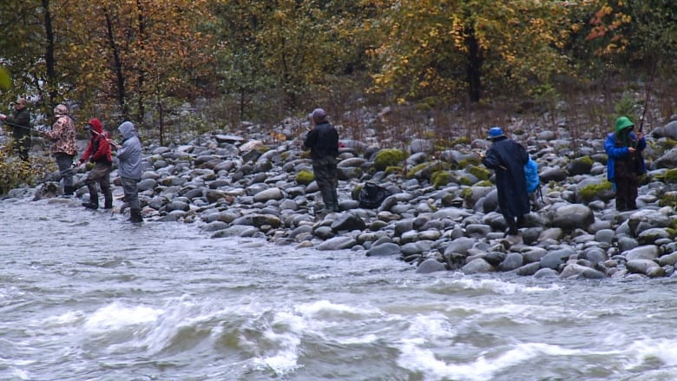
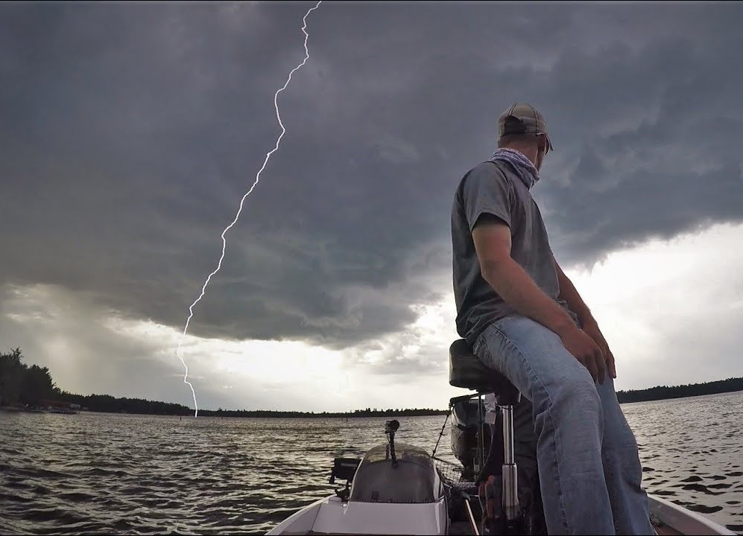
Hazards of Fishing
Drowning
Slipping, falling into the water or underwater holes
Being swept down river by flowing water
Lightning and storms.
Sunburn!
Dehydration and heat related injuries.
Insect bites and stings
Slipping or cutting yourself on sharp, rocky edges.
Cuts and puncture wounds from fishing equipment.
The farther out you go, the risks increase—so be prepared!

Slide 8
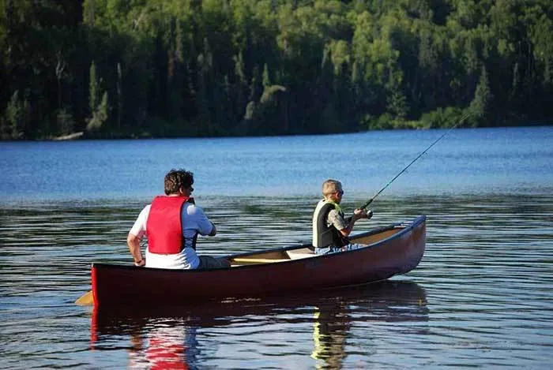
Keeping Safe while Fishing
Never go fishing alone – always fish with someone else and, ideally, with two other people.
Let somebody know the location of your fishing trip, who you are going with and an approximate time you will be back.
Wear a life jacket when fishing off rocks, ledges, a riverbank, wading, or a boat. A life jacket can save your life if you fall into the water, whether you are on a boat or near the water. It is extremely difficult to put on a life jacket when an emergency occurs or when you are in the water. It is safer to wear a life jacket at all times, before any emergency occurs.

Slide 9
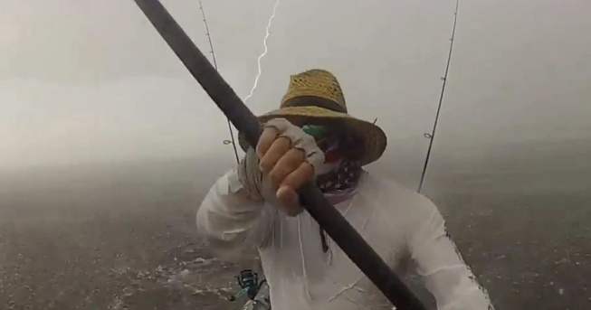
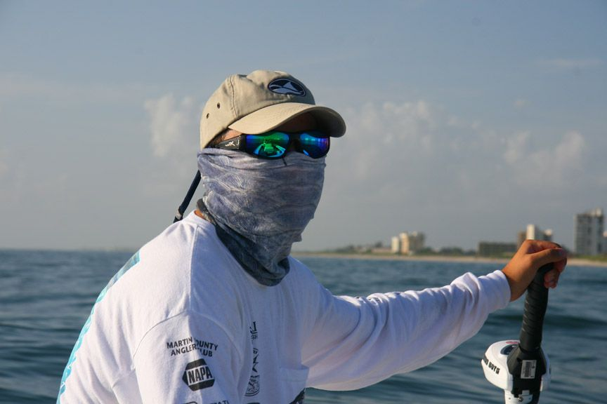
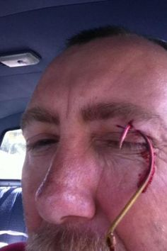
Keeping Safe while Fishing
Be aware of weather conditions and seek shelter during storms.
Wear non-slip shoes and take care to avoid slipping or cutting yourself on sharp, rocky edges.
Be SunSmart. Wear sun protective clothing, use SPF30+ (or higher) sunscreen and lip balm, wear an appropriate hat, seek shade where possible and wear sunglasses.
Take adequate drinking water.
Use an insect repellant that contains DEET.
Carry a first aid kit with you.
Stop fishing immediately if an injury occurs and seek prompt medical treatment.

Slide 10
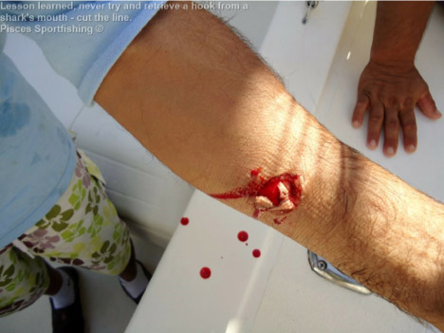
First Aid and Fishing
Cuts: Always wear latex gloves when applying first aid to a bleeding victim.
Treatment:
Clean the wound with an antibacterial and apply a bandage.
In almost all cases, applying "Direct Pressure" to the wound may stop bleeding. That is by pressing down upon the wound with your fingers or hand.
If a sterile dressing is available, it may be placed on the cut before pressing down, but if the bleeding is serious, DO NOT WAIT for the sterile material. It is better to have a live victim with a few germs than a sterile wound on a dead patient.

Slide 11
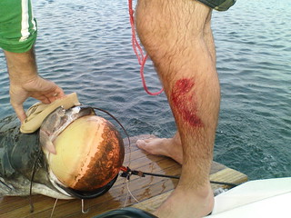
First Aid and Fishing
Scratches: Scratches are very common injuries that are usually caused by animals.
Treatment:
First, because scratches can easily become infected, you should clean the area thoroughly and remove any dirt and debris. Cover wound with gauze.
Do not scrub vigorously, as this can cause more tissue damage.

Slide 12
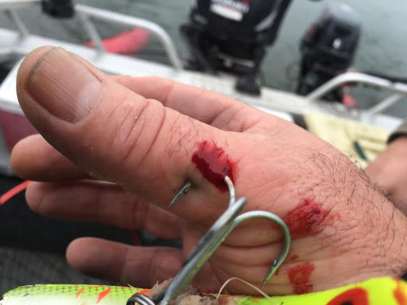
First Aid and Fishing
Puncture Wound: A puncture wound doesn't usually cause excessive bleeding. Often the wound seems to close almost instantly. But these features don't mean treatment isn't necessary.
Treatment:
Clean and cover the wound. Change the dressing regularly. Watch for infection.

Slide 13
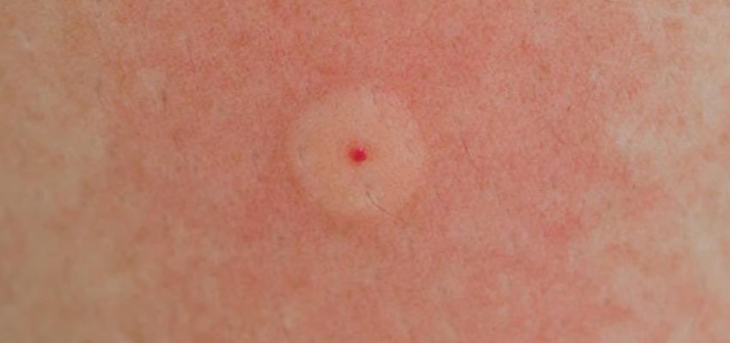
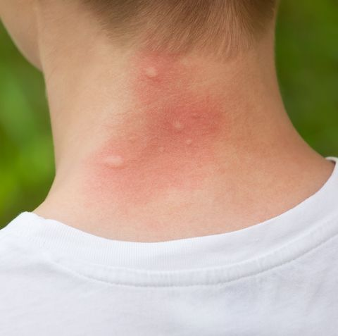
First Aid and Fishing
Stings: A sting or bite injects venom composed of proteins and other substances that may trigger an allergic reaction in the victim.
Symptoms:
Most bites and stings result in pain, swelling, redness, and itching to the affected area.
Severe reaction include hives, wheezing, shortness of breath, unconsciousness, and even death within 30 minutes.
Treatment:
If there is only redness and pain at the site of the bite, application of ice is adequate treatment. Clean the area with soap and water to remove contaminated particles left behind by some insects (such as mosquitoes). Refrain from scratching because this may cause the skin to break down and an infection to form.

Slide 14
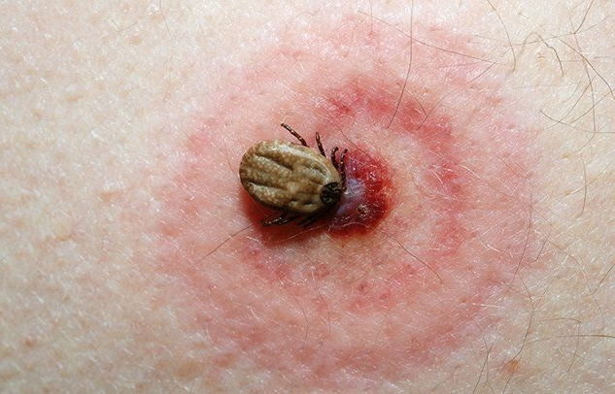
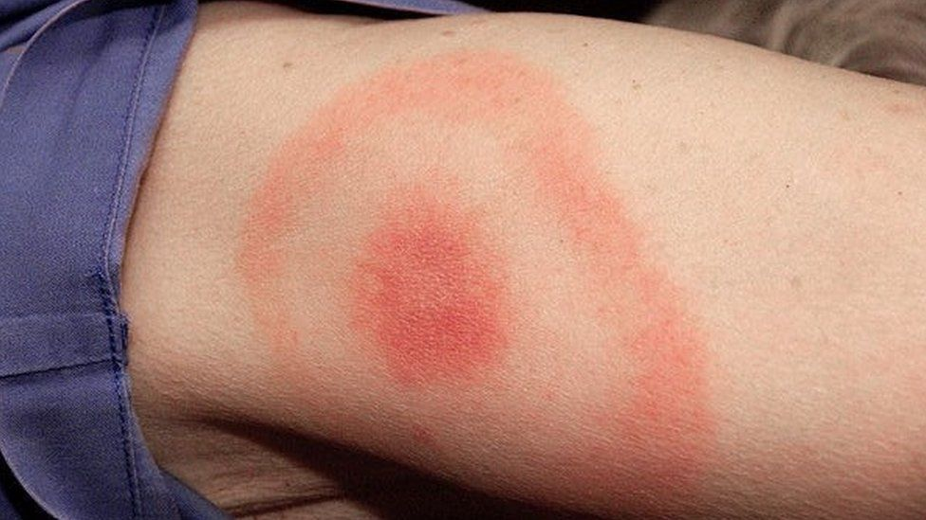
First Aid and Fishing
Tick bites: Second only to mosquitoes as vectors (carriers) of human disease.
Symptoms:
Redness, itching, and swelling
Lyme’s Disease: The hallmark target lesion, a red circular rash with a pale center, occurs at the site of the bite within 2-20 days after the bite in 60-80% of cases. The rash may be accompanied by fatigue, headache, joint aches, and other flulike symptoms.
Prevention/Treatment: Wear long-sleeved shirts, long pants cinched at the ankle or tucked into the boots or socks. If attached, using rounded tweezers, grasp the tick as close as possible to the skin surface, and then pull with slow steady pressure in a direction away from the skin.

Slide 15
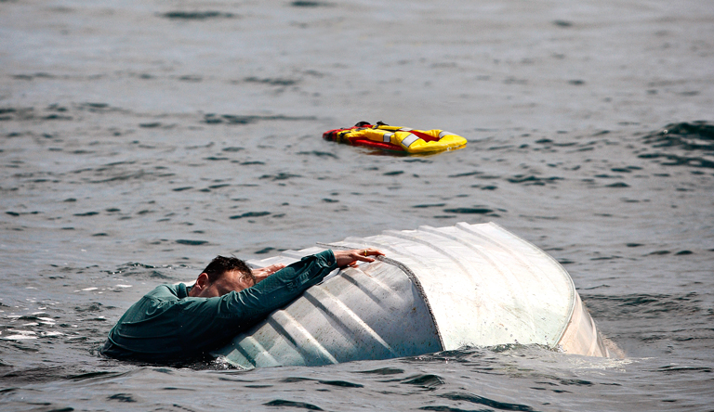
First Aid and Fishing
Hypothermia: Over-exposure to colder temperatures over time that result in a drop in body core temperature.
Symptoms:
Initial mental status changes in response to cold may be subtle and include hunger and nausea.
This will progress to apathy, confusion, slurred speech, and loss of coordination.
Many times a person will just lie down, fall asleep, and die.
Treatment: Removing them from the elements that caused the condition. Seek a dry, warm place away from the wind.

Slide 16
First Aid and Fishing
Dehydration: Occurs when the loss of body fluids, mostly water, exceeds the amount that is taken in.
Symptoms:
Weakness and/or dizziness
Confusion and/or sluggishness, even fainting
Inability to sweat
Decreased urine output. If urine is concentrated and deeply yellow or amber, you may be dehydrated.
Treatment: Sip small amounts of water or carbohydrate/electrolyte-containing drinks. Treat for heat Increased thirst with dry mouth and swollen tongue

Slide 17
First Aid and Fishing
Heat exhaustion: This condition often occurs when people exercise (work or play) in a hot, humid place and body fluids are lost through sweating, causing the body to overheat.
Symptoms:
Often pale with cool, moist skin
Sweating profusely
Muscle cramps or pains
Feels faint or dizzy
May complain of headache, weakness, thirst, and nausea
Core temperature elevated—usually more than 100°F—and the pulse rate increased
Treatment: oral fluids and cool, shading

Slide 18
First Aid and Fishing
Heatstroke: This medical condition is life-threatening. The person's cooling system, which is controlled by the brain, stops working and the internal body temperature rises to the point where organ damage.
Symptoms:
Unconscious or has a markedly abnormal mental status (dizziness, confusion, hallucinations, or coma)
Flushed, hot, and dry skin (although it may be moist initially from previous sweating or from attempts to cool the person with water)
May have slightly elevated blood pressure at first that falls later
May be hyperventilating
Core temperature of 105°F or more
Treatment:
Ice packs/sheets, IV fluids, and medical evacuation

Slide 19
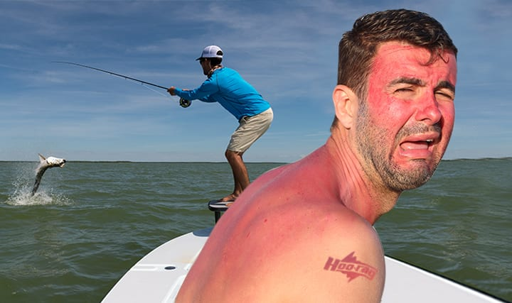
First Aid and Fishing
Sunburn: Excessive or prolonged exposure to the ultraviolet (UV) radiation of the sun. The time between 11 am and 2 pm contains the most powerful solar radiation exposure period.
Symptoms:
Sunburned skin is red and dry in exposed areas in a first-degree burn. Often, one may not realize that the skin is burned until ours later.
If exposure to the sun continues, second-degree burns may occur and blisters with clear fluid may form.
Treatment: Sun protection or appropriate coverings should be worn at all times, but especially during this time to decrease risk of sunburn.

Slide 20
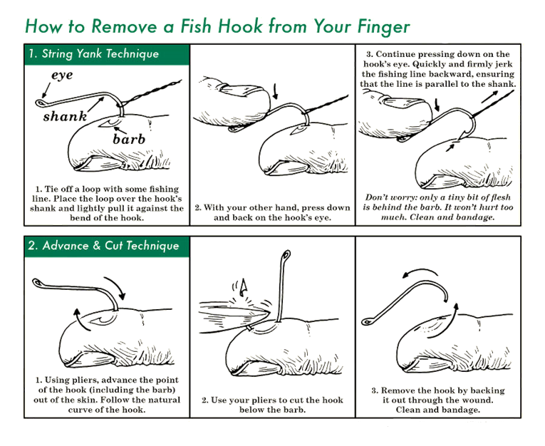

Slide 21
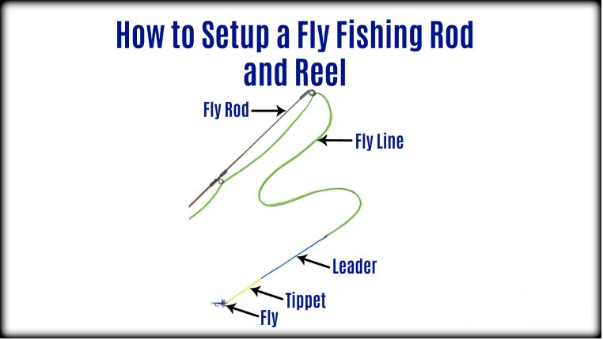
Requirement 2
Demonstrate how to match a fly rod, line and leader to achieve a balanced system. Discuss several types of fly lines, and explain how and when each would be used. Review with your counselor how to care for this equipment.

Slide 22
A Balanced System
When the rod, reel, and line are correctly matched to handle a given-weight fly line, they are considered to be in balance.
When in proper balance, they allow the angler to deliver a fly with accuracy within desired distance.
Modern tackle manufacturers continually test and upgrade their rods, reels, and lines to create better balance for line control and easier casting.
Fly-fishing requires a match between the rod and line, with the reel mainly functioning as line storage, although its weight can determine how easily casts can be made.
Fly rods usually are marked with numbers indicating which line works best on a particular model.

Slide 23
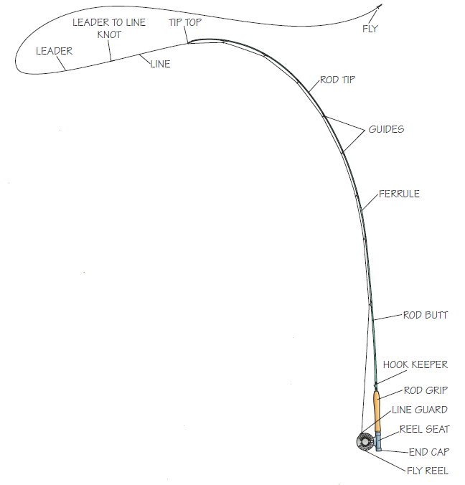
The Rod
A fly rod is long, usually 8 to 10 feet, and limber enough to flex when casting a line or playing a fish.
Most modern fly rods are made from a material called graphite.
Fly rods are tapered with a cork grip and a reel seat at the thick end.
Near the grip, you will find a small wire loop, called a hook-keeper, that holds the hook of a fly safely when it is not in use.
Spaced along the length of the rod are several guides, designed to run the line to the rod tip.
The last guide, at the tip of the rod, is called the tip top.
For convenience while traveling, most rods are designed to be broken down into at least two and sometimes as many as 10 sections.
The joints where the rod comes together are called ferrules.

Slide 24
Selecting a Rod and Line
A fly rod is a long lever that flexes.
As it flexes more deeply, it delivers longer casts.
Every fly rod is designed to be matched to a line of specific weight.
Lines of lighter weight are matched to more delicate rods.
Anglers use these, in general, to deliver tiny artificial lures (flies) to where they believe a fish may be lurking.
The rod and the line must match because the weight of the line is what causes the rod to flex and turn the line over in a smooth, efficient cast.

Slide 25
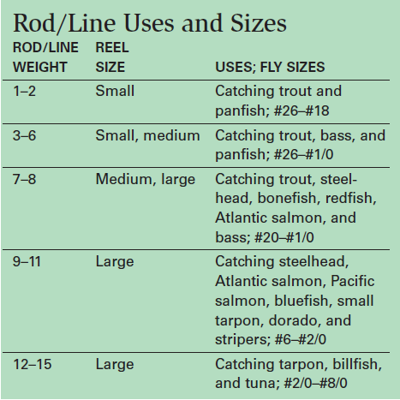
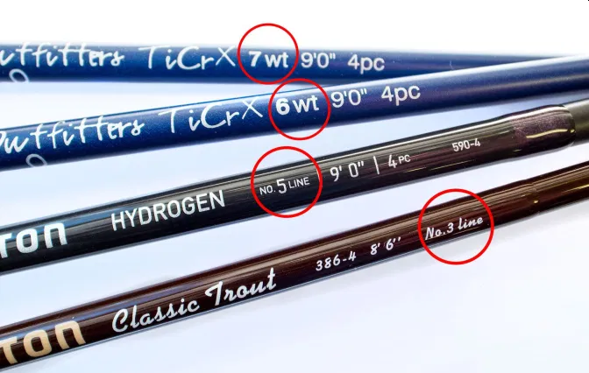
Selecting a Rod and Line
Manufacturers label each rod according to the size of the line it is designed to cast.
This information, along with the rod’s length and weight in ounces, will appear on the rod, usually just above the grip.

Slide 26
Rod Length
Fly rods can be as short as 6 feet and as long as 15 feet or more.
Many anglers use one-handed rods between 7 ½ and 9 ½ feet in length.
Shorter rods are desirable on close brushy streams. Longer rods enable the angler to make higher back casts and to keep the line and the fly above obstructions such as grass and brush.
Rods longer than 10 feet are generally used by anglers who employ a specialized two-handed casting technique, called spey casting, that is popular on some salmon and steelhead rivers.

Slide 27
Rod Length

Slide 28
Lines
Most fly lines are 80 or 90 feet long.
Lines vary by weight, and must be matched to the rod.
They come in different styles (called tapers) and are designed either to float on the surface of the water or to sink to different depths at different rates.

Slide 29
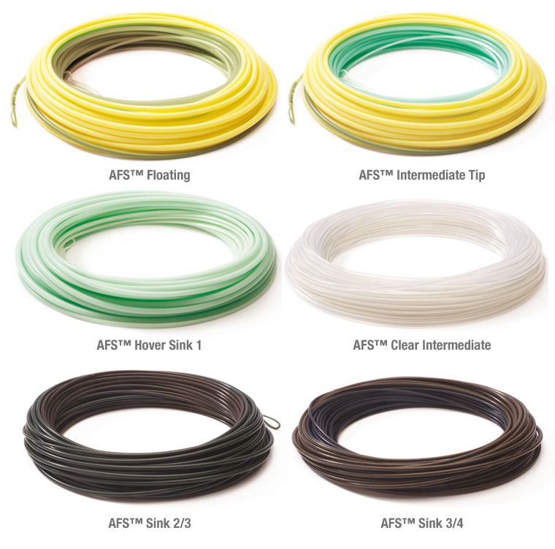
Lines
Fly lines come in different colors.
Sinking lines usually come in drab, darker colors so that the fish cannot spot them.
Floating lines can be very brightly colored, even fluorescent.
Many anglers prefer these lines for their high visibility.
In low light conditions, a darker line can be hard to see on the water.
A visible fly line can be the best means of keeping track of the location of small flies on the water.

Slide 30
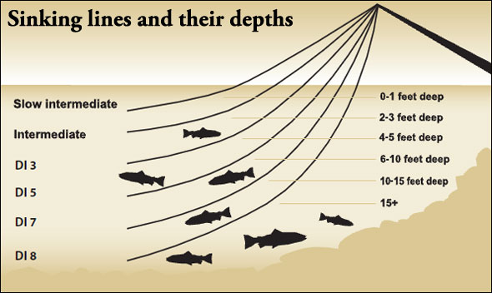
Lines
Most fly-fishing is done with floating lines, which are the easiest to cast and control but there are times and conditions when fish lie deeply in the water and are not feeding at or near the surface.
A sinking line is then useful to get the fly down to them.
Intermediate lines, for example, sink very slowly and can be fished just below the surface.
Heavily weighted lines sink quite rapidly and are designed to get down deep very quickly.

Slide 31
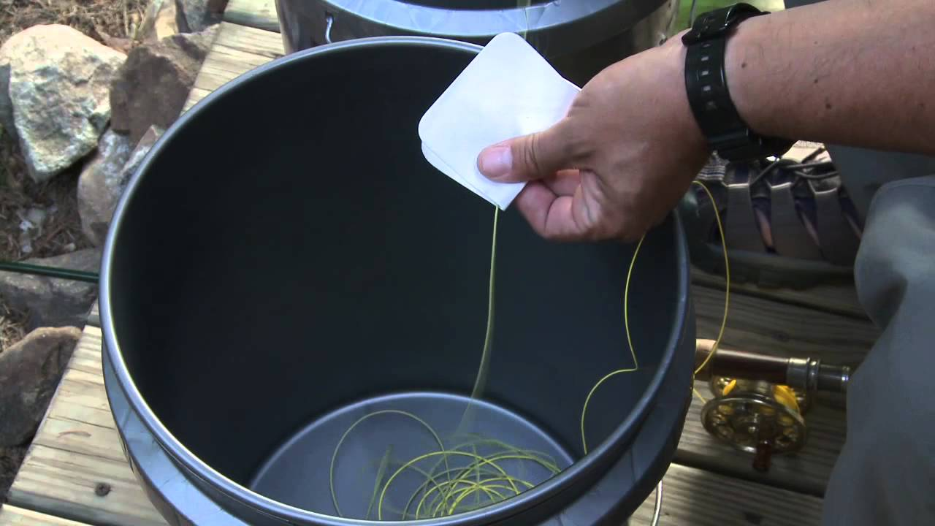
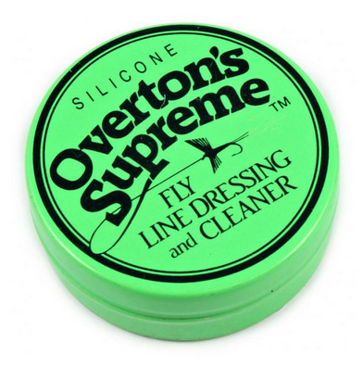
Lines
Fly lines are constructed of a soft, strong core with a tough, enamel-like coating.
Avoid situations that might cause nicks or small cuts in the fly line, taking special care not to step on the line.
Heat and sunlight are the greatest threats to a fly line, so do not store a reel with a line on it in a hot place or leave it in a car trunk for long periods of time.
A properly maintained fly line should last several years.

Slide 32
Fly Line Tapers
Fly lines of all weights are designed in different tapers, which describe the shape of the line. The narrow point of the line allows for delicate presentations.
A line that is of the same diameter throughout its length is called “level.” Level line is inexpensive but is not recommended for casting.
A line that has its widest diameter at the midpoint is called a double taper. This is a popular line for some kinds of fishing, especially those requiring shorter casts. Because the fly line is 90 feet long and the angler seldom uses more than half of that to cast, when one end of the line becomes nicked or frayed, it can be reversed to make use of the other end.
A weight-forward taper line bulges to its widest diameter about 20 feet from the end of the line. This puts the weight up front and makes the rod flex efficiently without casting an especially long line. The line behind the bulge is narrow in diameter. The heavy forward line is designed to pull or “shoot” the lighter line following it.

Slide 33
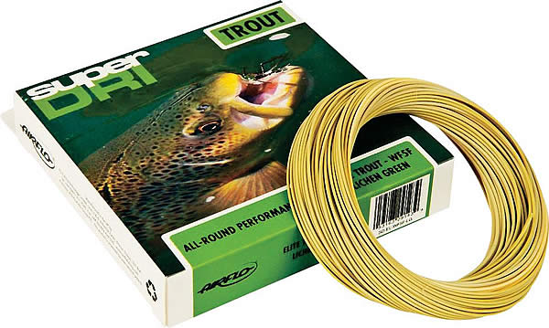
Decoding a Fly Line
When you buy a fly line, the information about that line is marked on the packaging in a kind of code.
For instance, you might see the following: WF5F. The first two letters of the code tell you the taper of the line. In this case, it is a weight-forward taper. Other designations include DT (double taper) and L (level).
The number that follows the taper designation is the weight of the line. In this case, the line is a number 5.
The letters that follow the number indicating the weight of the line tell you whether the line floats or sinks. In this case, the F indicates that this is a floating line. Other designations could be S (sinking), F/S (sink tip), I (intermediate), HD (high density or fast sinking).

Slide 34
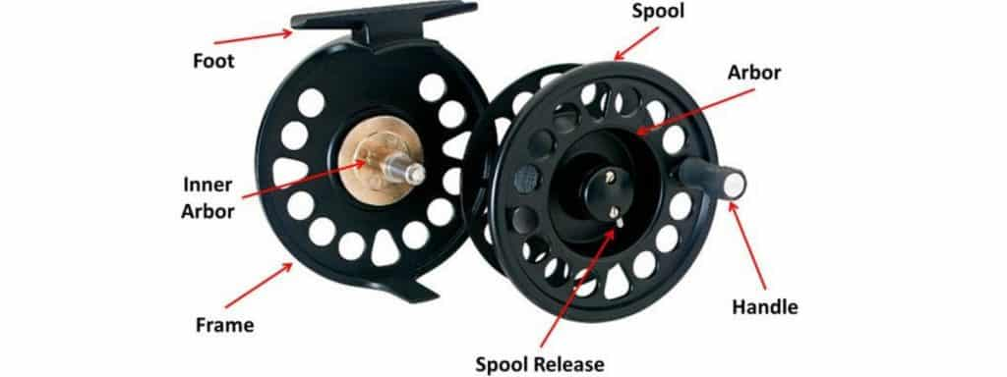
Fly Reels
A fly reel stores line and puts tension on the line when a fish makes a long run and is pulling line off the reel. A fly reel is an essential piece of equipment in fly-fishing, but it is not as specialized as the rod or the line.

Slide 35
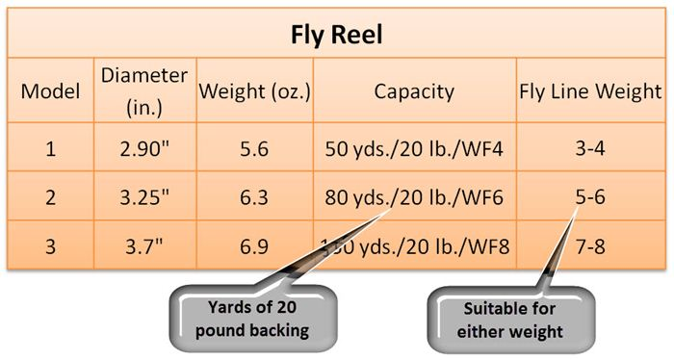
Fly Reels
When selecting a reel, choose one that is the right general size for the kind of fishing you plan to do.
It should have the capacity to hold the selected line and some backing (the line that goes on the reel before the fly line).
Manufacturers will indicate a reel’s line capacity somewhere on the packaging.
For instance, the manufacturer might state that a reel is designed for a WF5F line with 100 yards of backing.
This means you could use a little heavier line with a little less backing or a lighter line with more backing.

Slide 36
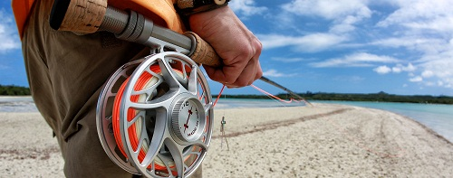
Fly Reels
If you plan to fish in salt water, make sure that the reel you choose is designed for this kind of use. It should be made of corrosion-resistant material such as anodized aluminum for the frame and stainless steel for the inner workings.

Slide 37
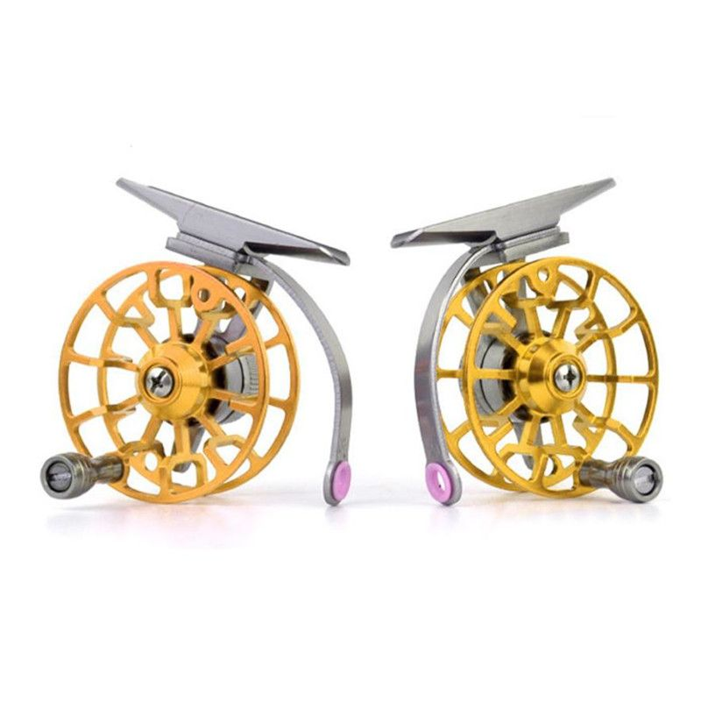
Fly Reels
Next, decide which hand you will use to reel in line.
Some anglers prefer to cast and reel with the same hand—which means they have to switch rod hands when they are playing a fish or retrieving loose line—while others cast with one hand and reel with the other.
Most reels are designed for right-hand retrieve.
Most smaller reels can be changed over to left-handed retrieve in a few simple steps to change the click mechanism, involving nothing more than a screwdriver.

Slide 38
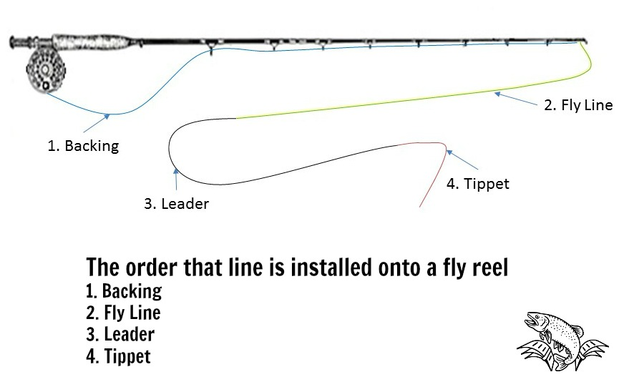
Backing
Backing is the line that goes on the reel before the fly line.
It is generally made of polyester fiber of a fine diameter and costs less than coated fly line.
In the case of larger reels for bigger fish, there may be as much as 300 yards of backing.
There are two reasons for using backing.
The first is that some big fish will run much farther than the length of the fly line.
The second reason for backing is that the reel spool is generally of fairly small diameter and fly line tends to hold a coiled shape when it comes off the reel. The closer to the spool, the tighter the coils and the harder they are to pull out of the line. With backing on a reel, the fly line comes off in wider coils that are easier to manage.

Slide 39
Leaders
The leader is a transparent plastic line tied between the end of the fly line and the fly.
It is often tapered to a very fine point to which the fly is tied.
Leaders are supple, so they do not hinder the natural action of a fly. Smaller flies call for finer leaders.
They are transparent so that they are hard for a fish to see.
Usually they are 6 to 12 feet in length. In general, clearer water demands longer leaders.
A leader that is too short will cause the fly line to land too close to fish and possibly alarm them.
A leader that is too long may be difficult to control, especially under windy conditions on brushy streams.
With a proper cast a leader would efficiently transmit the flow of energy all the way down to the tippet, which would straighten out and allow the fly to fall gently on the water.

Slide 40
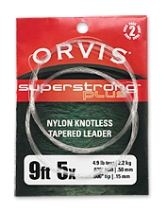
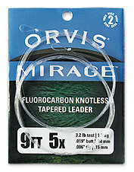
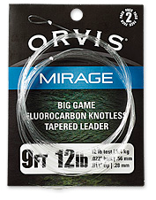
Avoiding Leader Problems
It is possible that more hooked fish are lost because of leader problems than for any other reason.
Many fish are never hooked in the first place because the fisherman was using the wrong leader, one that made it impossible to cast properly or one that did not allow the fly to behave like a natural prey.
Leaders become damaged during a day of fishing by picking up nicks from rocks or branches or become knotted when the angler makes a poor cast and throws what is called a tailing loop.
These wind knots can decrease the breaking strength of a leader by as much as 50 percent.
Leaders should be inspected for such knots and damage.
If you find a knot, take it out of the leader.
If the leader looks frayed, repair the damaged section of the leader and tie on new tippet material or replace the entire leader.

Slide 41
Tippets
The tippet is a specific gauge monofilament line that is attached to the end of the leader, to which you tie the fly. The tippet is usually the smallest gauge line on your rig and is virtually invisible to the fish. The tippet is also very flexible and allows your fly to float or swim more naturally.
Normally the tippet is 2 to 4 feet in length and matches, or is smaller than, the diameter of the leader's tip. The biggest advantage to using tippet is that it extends the life of the leader. Leaders can be expensive and if you change flies often, little by little the taper of the leader is cut away. By tying on tippet, you can avoid losing taper.

Slide 42
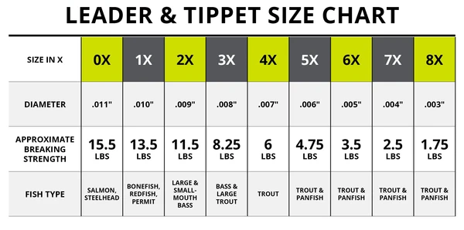
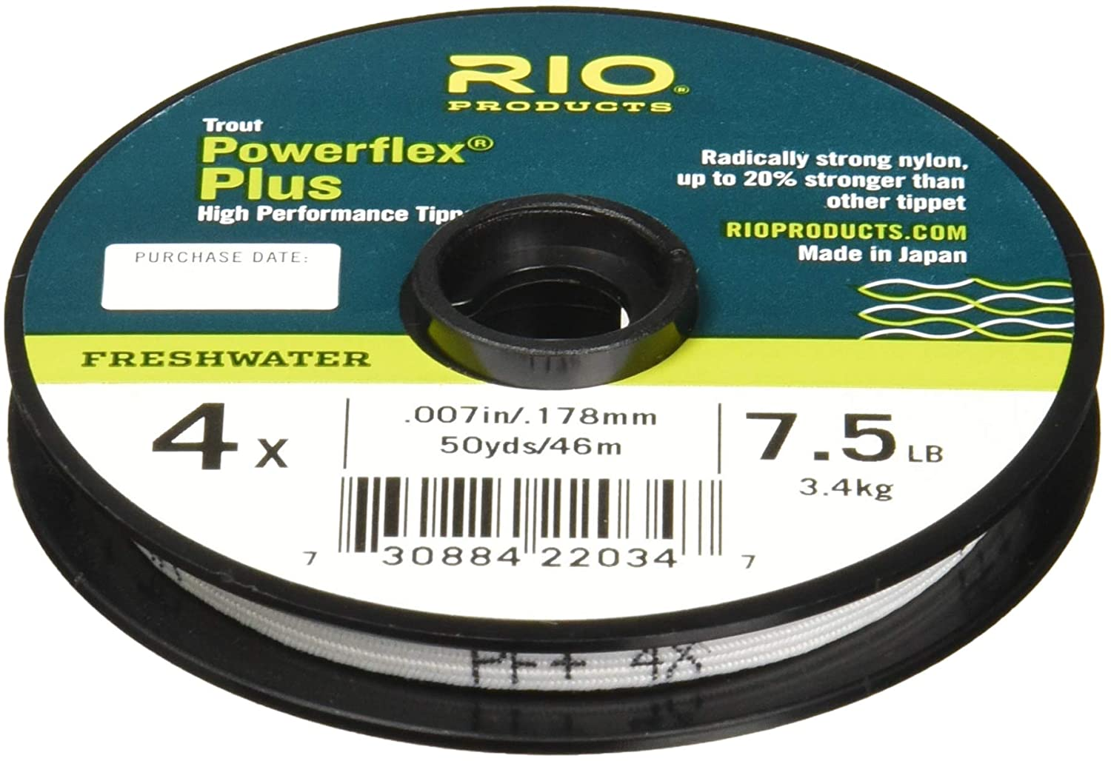
Tippets
Choose a tippet fine enough to allow the fly to move naturally and strong enough to hold a fish.
Tippets are measured by diameter and a heavy tippet is a 0X while a very fine tippet is 8X.

Slide 43
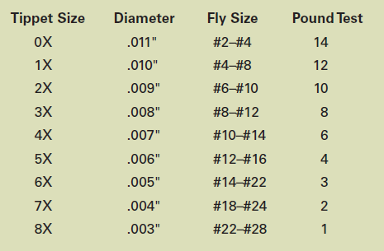
Tippets
The fly is tied to the end of the tippet. What type of fish you are angling for determines the type and size of the fly. Flies come in all different shapes and sizes that range from very small #28 to large #2. There are still larger flies, but they are categorized on a different scale.
Tippet size and length is critical. A tippet that is too fine for the fly that is being fished will collapse at the end of the cast instead of unfurl. A tippet that is not fine enough will cause the fly to behave unnaturally.
While tippet size and strength may vary among manufacturers, this chart describes tippet diameter, pound test of breaking strength, and the appropriate fly size to use.

Slide 44
Requirement 3
Demonstrate how to tie proper knots to prepare a fly rod for fishing:
Tie backing to the arbor of a fly reel spool using an arbor knot.
Tie backing to the fly line using a nail (tube) knot.
Attach a leader to the fly line using a nail (tube) knot or a loop-to-loop connection.
Add a tippet to a leader using a surgeon's knot or a loop-to-loop connection,
Tie a fly onto the terminal end of the leader using an improved clinch knot.

Slide 45
The Arbor Knot is used to attach the fishing line to the “Arbor” or “Spool Center”.

Slide 46
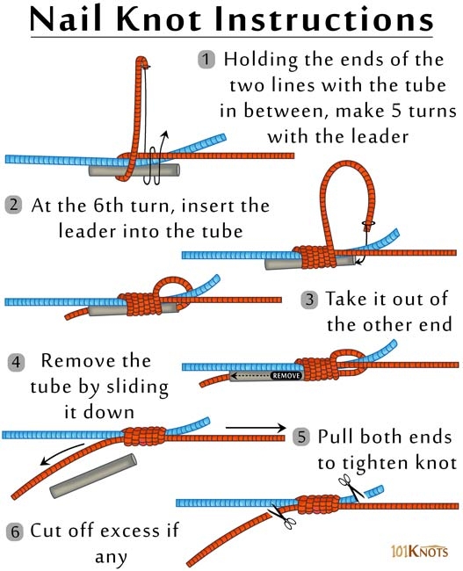
The nail knot is a very significant fishing knot that is widely used to connect the fly line to the leader. It is good for joining two lines of different diameters allowing you to attach backing to the fly line and the fly line to the leader, or the tippet. The knot derives its name from the use of a nail that originally acted as a guide for making the knot. However, replacing the nail or a needle with a thin hollow tube or straw, as described below makes the tying easier

Slide 47
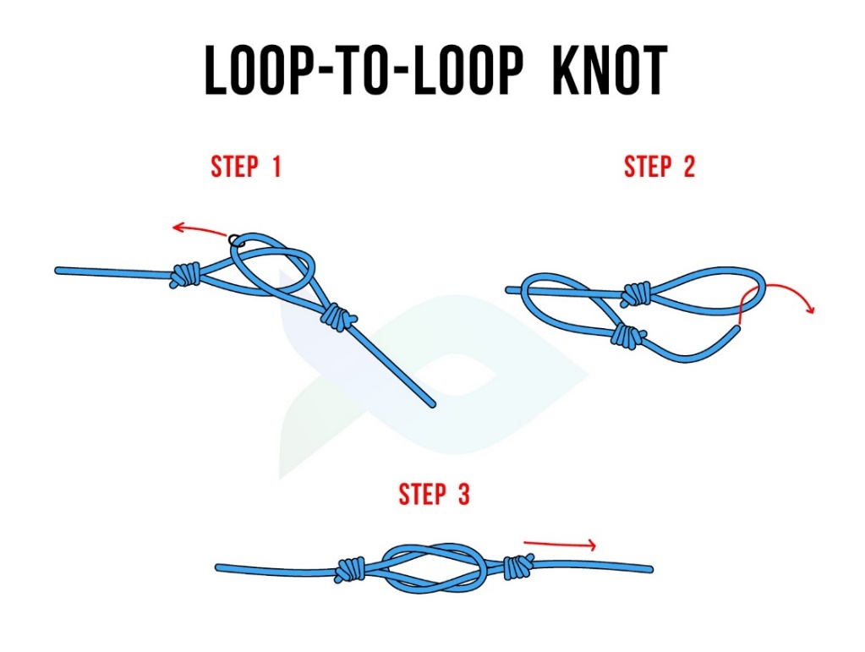
The Loop-to-Loop Knot is not really a knot. It is a method of joining or interconnecting
two loops and is often referred to as interlocking loops.
Slip one loop over the other loop. (Fly Line in left hand, leader in right hand; Leader loop over Fly Line loop).
Run leader line through same Fly Line loop.
Pull lines in opposite directions to lock the loops together. Be careful that the loops join together end-to-end and that one does not fold back forming a girth hitch. (Fly Line in left hand, leader in right hand; Leader loop over Fly Line Loop).

Slide 48
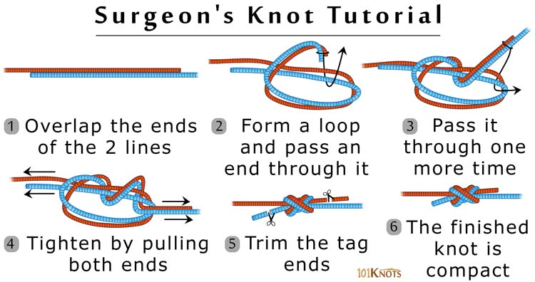
Based on the square (reef) knot, the surgeon’s knot owes its name to its common use by surgeons to secure the threads in a suture. Though originally a surgical knot it has found wide use in fly fishing to effectively connect the leader to the tippet. It joins 2 lines of equal or unequal diameters as well as lines of different materials.

Slide 49
The improved clinch knot is used for securing a fishing line to the fishing lure, but can also affix fishing line to a swivel, clip, or artificial fly. This is a common knot used by anglers because of its simple tie and strong hold.

Slide 50
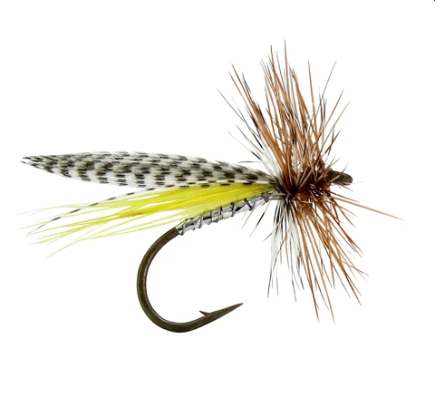
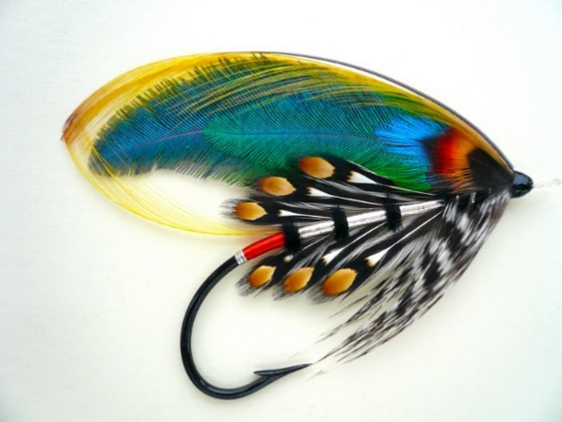
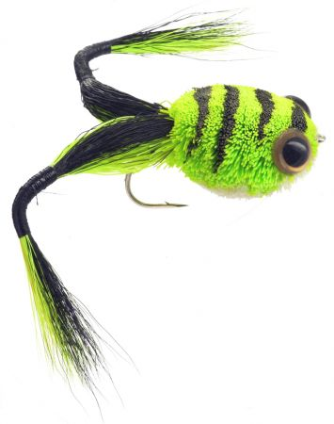
Requirement 4
Explain how and when each of the following types of flies is used: dry flies, wet flies, nymphs, streamers, bass bugs, poppers , and saltwater flies. Tell what each one imitates. Tie at least two types of the flies mentioned in this requirement.

Slide 51
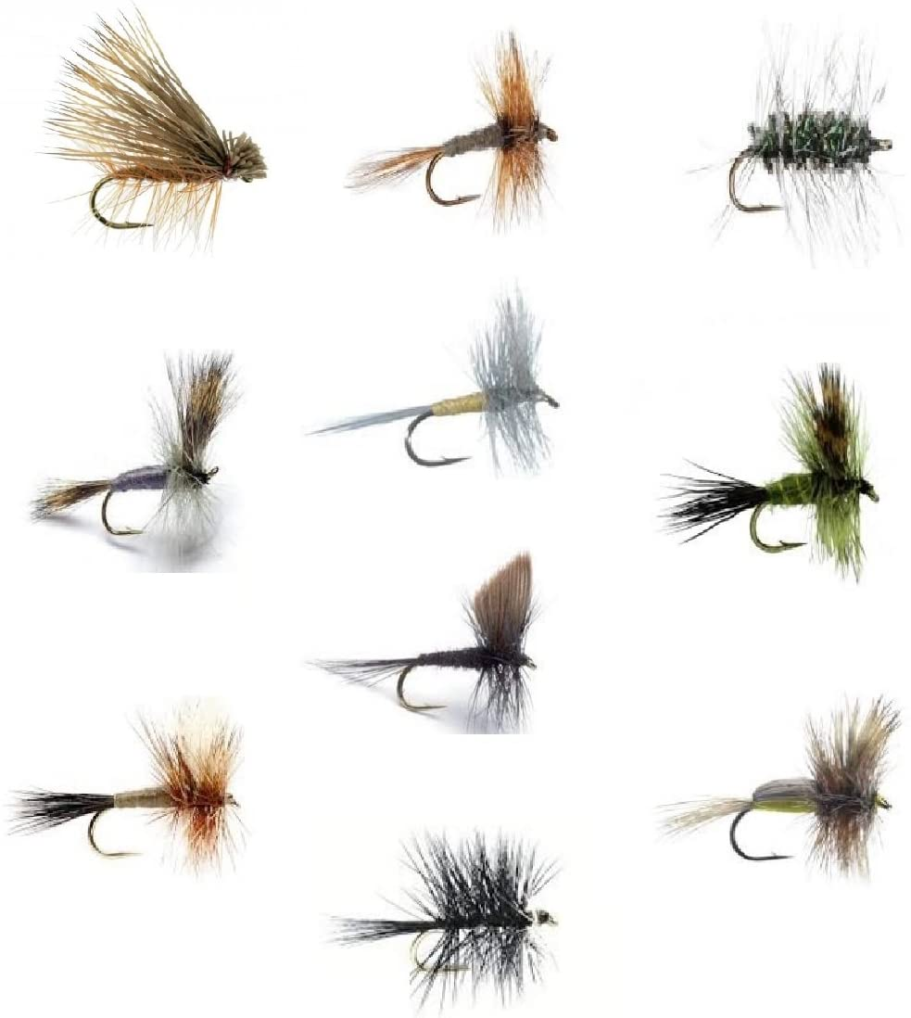
Dry Flies
A dry fly is designed to land softly on the surface of the water without breaking it and becoming wetted.
It need not be inherently buoyant.
They are often oiled or treated with another water repellent.
Dry flies are generally considered to be freshwater flies.

Slide 52
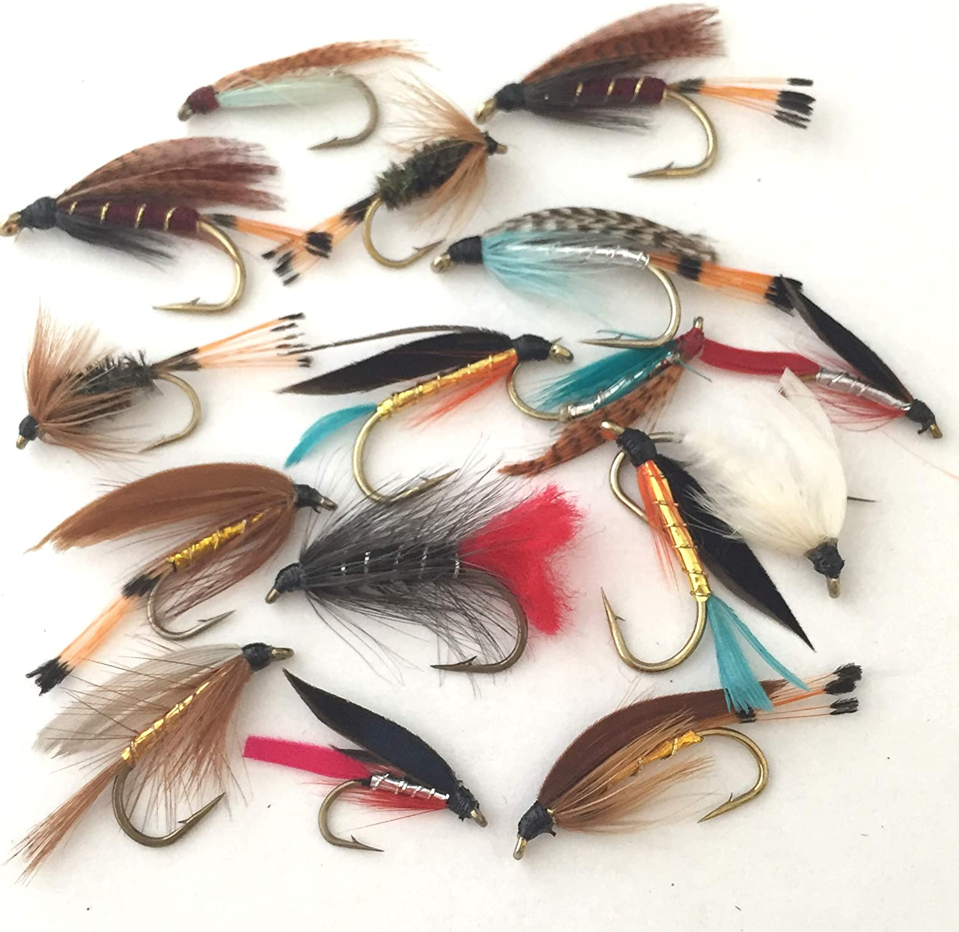
Wet Flies
A wet fly is designed to be fished below the water's surface mimicking a variety of insects and emerging insects.

Slide 53
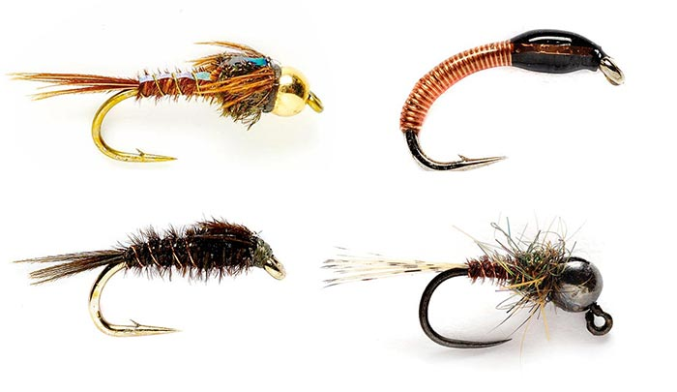
Nymphs
A nymph fly is a type of fly fishing fly that imitates the naturally occurring insect larva and nymphal stages of aquatic insects commonly found in streams, rivers, ponds, and lakes.

Slide 54
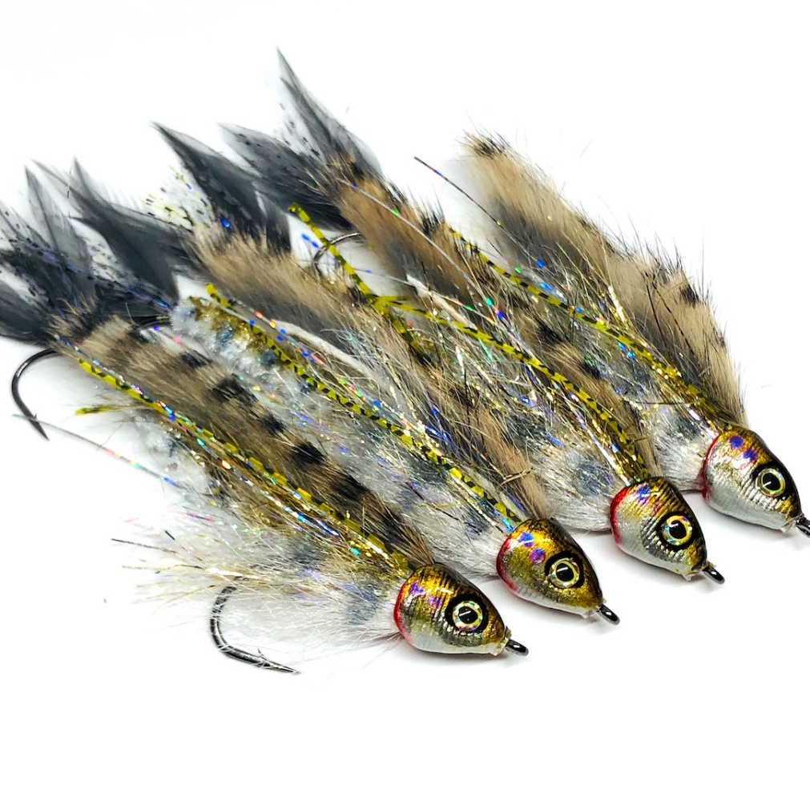
Streamers
Streamers are bigger flies that you fish on an active retrieve, and these flies imitate baitfish, crayfish, leeches, and large aquatic insects like hellgrammites.
Streamers are the fly-fishing equivalent of conventional lures.
Because the fly is usually moving, strikes can be explosive.

Slide 55
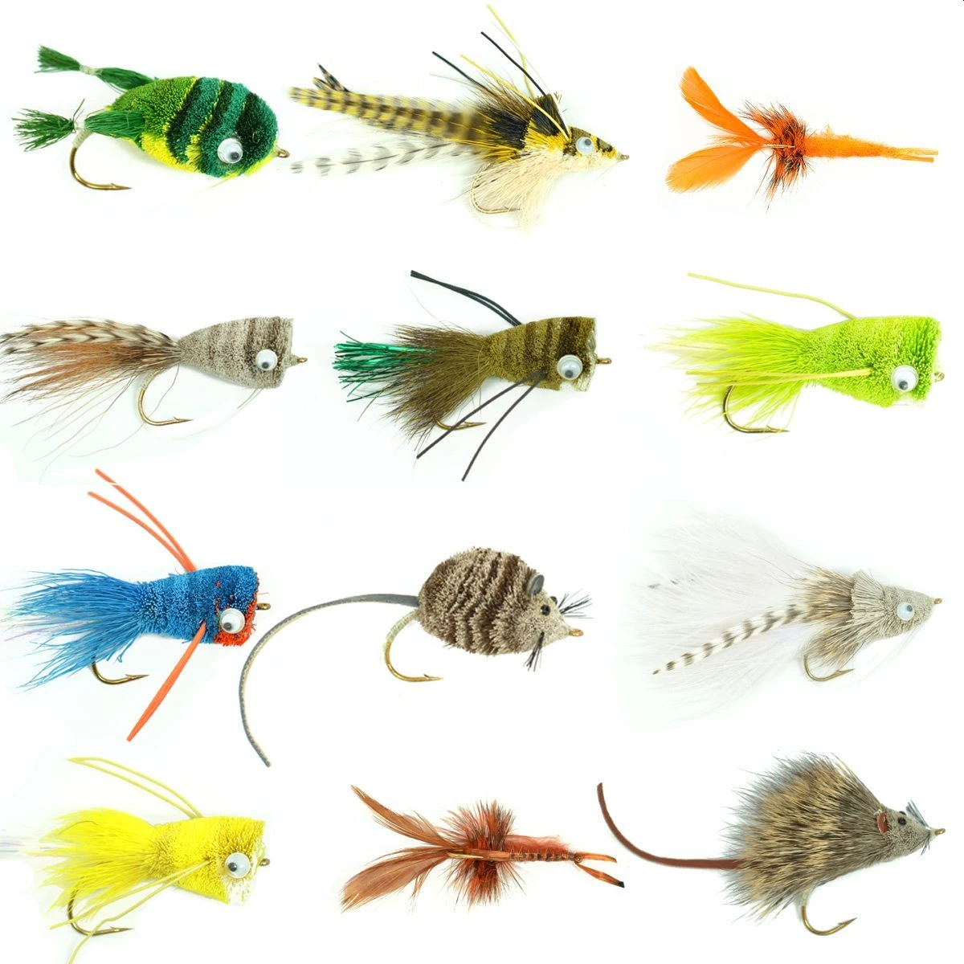
Bass Bugs
Floating bass flies whether constructed of wood, plastic, foam, or deer hair are all lumped into the same category of “bass bugs”.
A few are tied to imitate specific bass foods like mice, leeches or frogs, but others are ‘attractors’ that try to give the impression of something living and edible.

Slide 56
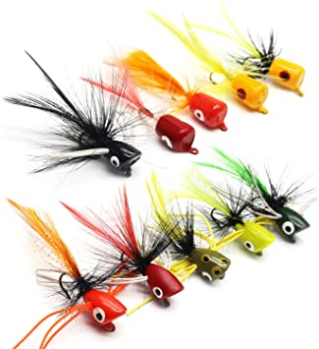
Poppers
The popper is an effective and proven lure designed to move water using a concave or hollowed nose.
Poppers aim to simulate any sort of distressed creature that might be moving or struggling on the surface of the water (baitfish, frogs, and insects are the most typical imitations).

Slide 57
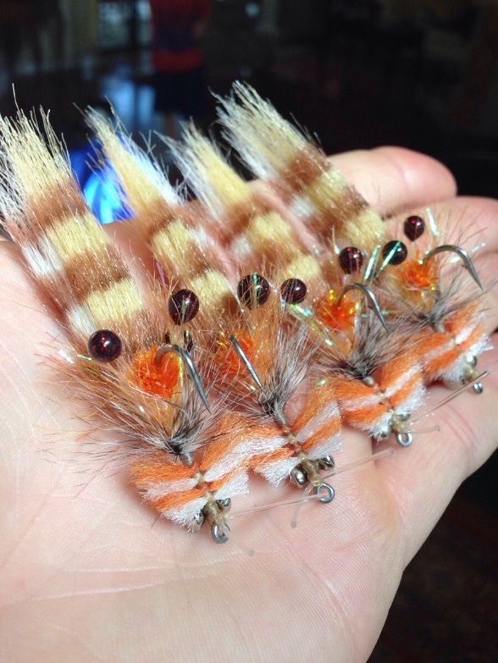
Saltwater Flies
Salt water fly fishing typically employs the use of wet flies resembling baitfish, crabs, shrimp and other forage.

Slide 58
Requirement 5
Demonstrate the ability to cast a fly 30 feet consistently and accurately using both overhead and roll cast techniques.

Slide 59
Overhead Cast
Set the fly line about 1–2 feet (0.30–0.61 m) longer than the fishing rod.
The weight of the fly line is what allows you to cast, so you need to have enough of the heavier line pulled out before you try to cast.
An easy way to ensure you have enough fly line is to let out enough to reach the reel at the bottom of the rod with about 1–2 feet (0.30–0.61 m) of extra length.

Slide 60
Overhead Cast
Use an overhead cast to get used to casting a fly fishing rod.
The overhead cast is the standard fly fishing cast. Mastering the overhead cast requires knowing how to properly “load” the rod, which refers to finding the tension in the line and pole to cast the fly lure.
Before you move on to more advanced casts, learn to use the overhead cast.
The overhead cast is harder to perform when there are lots of low hanging branches because the line can get tangled easily.

Slide 61
Overhead Cast
Stand with your feet shoulder-width apart.
For short to medium ranged casts, adopt a parallel stance so you're stable and in a better position to “feel” the weight of the fly line on the rod.
Keep your feet evenly spaced apart and your weight centered rather than on the balls of your feet or your heels.
For longer casts, you may feel more comfortable standing with 1 foot forward so you can reach further behind you for a stronger cast without losing your balance.

Slide 62
Overhead Cast
Hold the rod with your thumb on top of the grip.
Don't squeeze too tightly or you won't be able to perform the quick stop at the end of the stroke.
Keep a loose, comfortable grip and hold the rod in line with your intended target area.
Allow the rod to rest in your fingers and only squeeze the grip when you force it to stop at the end of each stroke.
Keep the butt of the fly rod in line with your forearm.
Make sure the reel of the rod is pointed down toward the ground.

Slide 63
Overhead Cast
Lay the line straight on the ground in front of you.
In order to generate enough momentum in your backswing, start by stretching out about 10 feet (3.0 m) of the line from the end of the rod.
Aim the line completely straight and stand square to your target.
Make sure that the leader and tippet don't get tangled up.

Slide 64
Overhead Cast
Bring the rod up and backward in 1 motion.
Keep the tip of the rod low until you're ready to cast and use a smooth and fluid motion to bring the rod up and behind you.
This will cause the rod to bend and load up with tension. Think about snapping a long whip.
The line should move up and overhead as it travels behind you in a large arc.
The biggest mistake that people make when they're casting a fly fishing rod is trying to cast too fast.
You have to pause slightly on the back cast or forward fast to allow the line to build momentum.

Slide 65
Overhead Cast
Stop the rod abruptly once it passes a vertical position.
When you straighten the rod out above your head and it passes behind you, stop its acceleration abruptly and deliberately so the line is launched behind you.
Hold the rod still as the line travels backward.
Think about stopping the rod at about the 1 or 2 o'clock position behind you.
If the line falls short before it completely unrolls behind you, you may not have put enough energy or power in your cast.
Straighten the line back out in front of you and try again!

Slide 66
Overhead Cast
Allow the line to unroll in the air behind you.
With the rod still extended above and slightly behind you, wait for the line to travel behind you and rise as it unrolls.
The energy from the backward motion will cause it to move until it extends completely.
Make sure you pause long enough to allow the line to fully unfurl.

Slide 67
Overhead Cast
Move the rod forward to bring the line in front of you.
As soon as the line is fully extended in the air behind you, use a smooth, accelerating stroke to bring the rod forward.
The line will snap forward and form a loop in the air as it travels.
Keep your wrist straight and your elbow close to your body to generate a fluid movement.

Slide 68
Overhead Cast
Lower the tip of the rod as the line unrolls in front of you.
Stop the rod once it's about parallel with the ground to allow the energy in the line to propel it forward.
As the line unrolls in front of you, slowly lower the tip of the rod to roll the line out all the way to the fly at the end.
The line should end right where you were aiming.
Don't snap the rod down sharply or the tension in the line could cause the cast to go straight down before it has reached its target.

Slide 69
False Casting
If you have made the forward cast and, instead of softly lowering the rod tip and letting the line and fly settle on the water, you execute another back cast with the fly still in the air, you are false casting.
False casting allows the angler to change directions from cast to cast without disturbing the surface of the water and to add more length to the cast.
It is also a good way to dry a fly that has soaked up too much water.
Practice false casting 30 feet of line. Much more than this is unwieldy.

Slide 70
False Casting
Even though a false cast may be necessary at times, false casts do not catch fish.
Try to minimize doing things that do not catch fish.
Fly line waving back and forth in the air too much could scare fish in low, clear water. Minimizing false casting helps an angler make a better effort of not disturbing fish, which leads to catching more fish.
Too many false casts also have a tendency to lead to more tangles. Not only are tangles frustrating to fight with, they take away time that could be spent catching fish. Minimizing false casting generally minimizes those extra tangles, or “wind knots”.

Slide 71
False Casting
Most advanced fly anglers agree that it should take a maximum of three false casts to reach your intended target or change direction in normal fishing situations.
Less is always better. Remember, you can't catch a fish if your fly is whirling about in the air above you, so put it in the water where it belongs!

Slide 72
Performing a Roll Cast
Use the roll cast when you're fishing in narrow waterways.
The roll cast will cause the line to smoothly unroll over the surface of the water and is less likely to disturb fish, but it's also a little more difficult to perform.
It's also important that the line is in water because the water anchors it and allows you to create a loop.
A roll cast is great to use when you're fishing in narrow creeks or streams.
The roll cast is also effective if you have a strong wind at your back that is interfering with your overhead cast.

Slide 73
Performing a Roll Cast
Draw the rod up and back to drag the end of the line across the water. Start with about 25 feet (7.6 m) of line laid out in front of you on the water and the tip of your rod pointed at the surface. Use a slow and smooth motion to bring the rod back and drag the line over the surface of the water.
Tip: Make sure you don't pull the line out of the water. The friction of the line and the water is what loads the rod and allows you to cast it forward.

Slide 74
Performing a Roll Cast
Stop the stroke with the rod tip high when a loop has formed behind you.
As soon as your rod reaches just past a vertical position, stop and hold it in position.
The line should be slack and droop behind the tip of the rod, creating a loop.
The larger the loop, the more power you can generate to cast the line forward.

Slide 75
Performing a Roll Cast
Accelerate the rod forward quickly.
Once you've formed the loop with the backward motion, quickly move the rod forward to start the forward cast.
Keep your hand high and the rod pointed up.
The line will start to roll over the surface of the water and move the direction of your cast.
Move forward with a smooth and consistent movement rather than a short and jerky motion.

Slide 76
Performing a Roll Cast
End the cast by stopping abruptly to allow the line to unroll.
As you move your rod forward, the loop will rise up.
Stop your cast abruptly once it's nearly parallel with the water.
The loop will roll out on top of the water and move to where you're aiming your cast.
Allow the end of the line to land gently on the surface of the water.

Slide 77
Requirement 6
Go to a suitable fishing location and what fish may be eating both above and beneath the water's surface. Look for flying insects and some that may be on or beneath the water's surface. Explain the importance of matching the hatch.

Slide 78
Matching the Hatch
“Matching the hatch” is an expression that comes from the fly-fisherman’s attempts to imitate natural insects with artificial imitations in order to fool fish.
Since trout can key in on certain menu items when they are available – and will often ignore all others – getting familiar with the bugs that are present in a stream at the moment you’re fishing can bring you one step closer to your goal of catching.
Basic streamside sampling can help cut down guesswork and give you a short list of viable offerings to try to replicate.

Slide 79
Matching the Hatch
The simplest form of streamside sampling is done by picking up and looking at submerged rocks.
Choose cobblestone-sized rocks that are easy to lift.
Under close inspection, you will find that most rocks have a number of insects crawling or clinging to their underside.
Even if you don’t know what type of insects they are, you can see its size, color and profile.
Already you have a starting point, as long as you have a decent match in your fly box.
Keep in mind that just because one type of bug is predominant in the sample, it doesn’t exactly mean that’s what the trout are keyed in on – it may take some trial and error.

Slide 80
Matching the Hatch
A more thorough stream sample can be taken by a method called seining.
A seine net is an effective and inexpensive tool that won’t take up too much room in your vest or chest pack.
An angler’s landing net can be used as a substitute, as long as the mesh holes have small enough diameters to not allow tiny insects to pass through during sampling.

Slide 81
Requirement 7
Do the following:
Explain the importance of practicing Leave No Trace techniques. Discuss the positive effects of Leave No Trace on fishing resources.
Discuss the meaning and importance of catch and release. Describe how to properly release a fish safely to the water.

Slide 82
Leave No Trace
To ensure a healthy future for ourselves and our environment, we must do more than simply pick up litter. We must learn how to maintain the integrity and character of the outdoors.
Plan Ahead and Prepare. Proper planning and preparation for a fishing trip helps ensure a safe and enjoyable experience while minimizing damage to natural and cultural resources. Anglers who plan ahead can avoid unexpected situations and minimize their impact by complying with area game and fish laws, such as size and catch limits, tackle and bait regulations, and seasonal restrictions. Failure to know and obey these laws can lead to an arrest and a fine. Be sure to obtain a fishing license if necessary and any other needed permits or permission before heading out on your fishing adventure.

Slide 83
Leave No Trace
Travel and Camp on Durable Surfaces. Whether you fish for a few hours or an entire day, or you plan to camp and fish, it is important to minimize your impact on the land. Damage to land occurs when visitors trample vegetation or communities of organisms beyond recovery. The resulting barren areas develop into undesirable trails, campsites, and fishing spots and cause soil to erode. If fishing from shore in high-use areas, concentrate activity where vegetation is already absent. Minimize resource damage by using existing trails and selecting designated or existing fishing areas. If camping overnight, always camp at least 200 feet from shorelines. It is especially important to avoid impacting stream banks and lakesides.

Slide 84
Leave No Trace
Dispose of Waste Properly. Pack it in; pack it out. This simple yet effective saying motivates outdoor visitors to take their trash home with them. Inspect your fishing spot, boat, or campsite for trash or spilled foods. Accept the challenge of packing out all trash, leftover food or bait, and used or broken fishing line. Use designated fish cleaning areas or check with the local game and fish officials if you will be fishing in a more remote area. You must properly dispose of any fish entrails or bodily waste in solid waste facilities or by burying them in a cathole. A cathole should be dug 6 to 8 inches deep in humus soil and should be at least 200 feet from water, trails, and campsites. If cooking in the backcountry, strain food particles from the dishwater and disperse the wastewater at least 200 feet from springs, streams, and lakes. Pack out the strained food particles. Use biodegradable soap 200 feet or more from any water source.

Slide 85
Leave No Trace
Leave What You Find. Allow others a sense of discovery, and preserve the past. Leave rocks, plants, animals, archaeological artifacts, and other objects as you find them. Examine but do not touch cultural or historical structures and artifacts that you may stumble across. It may be illegal to remove artifacts. Good fishing spots are found, not made. Avoid altering a site, digging trenches, or building structures. Never hammer nails into trees, hack at trees with hatchets or saws, or damage bark and roots by tying horses to trees for extended periods. Replace surface rocks or twigs that have been cleared from the fishing spot or campsite. On high-impact sites, clean the area and dismantle inappropriate user-built facilities such as log seats or tables and multiple fire rings.

Slide 86
Leave No Trace
Minimize Campfire Impacts. If you plan to cook what you catch while on a fishing trip, consider the potential for resource damage. Some people would not think of cooking or camping in the outdoors without a campfire. Yet the naturalness of many areas has been degraded by overuse of fires and increasing demand for firewood. A low-impact alternative is to use a lightweight camp stove. Stoves are fast, eliminate the need for firewood, and make cleanup after meals easier.

Slide 87
Leave No Trace
Respect Wildlife. Help keep wildlife wild. While fishing, chances are you will encounter other wildlife as well, on the shore or in the water. Avoid disturbing animals by observing them from afar and giving them a wide berth. You are too close if an animal alters its normal activities. Never feed wildlife (except the fish you’re trying to catch, of course!). Store food and garbage securely to avoid attracting wildlife. Be respectful of any catch-and-release areas, and return unharmed to the water any fish that you do not plan to eat or that exceed the designated limit.

Slide 88
Leave No Trace
Be Considerate of Other Visitors. Thoughtful anglers respect other visitors and protect the quality of their experience. The following are a few tenets of outdoor ethics:
Travel in small groups. If camping, do so in groups no larger than that prescribed by the land managers.
Let nature’s sounds prevail. Keep the noise down and leave radios, music players, and pets at home. Fish can be spooked by such interruptions. In bear country, however, being a bit talkative on the trail might help prevent a surprise encounter with a bear.
Select fishing spots and campsites away from other groups to help preserve their solitude and their chances of catching fish.
Always travel quietly to avoid disturbing other visitors. If fishing from a watercraft, take care not to disturb other anglers’ efforts on the water.
Respect private property and leave gates (open or closed) as found.

Slide 89
Catch and Release
Catch and release helps prevent overfishing.
Use artificial lures with barbless single hooks. Fish tend to swallow live bait more deeply, and barbless hooks are easier to remove and do less damage than barbed hooks.
Play the fish, then release it as gently and quickly as possible. Do not play the fish to exhaustion, or it may not recover.
If the fish has swallowed the hook, cut off the line as close to the hook as possible. Never try to remove a deeply embedded hook because you may damage the fish beyond recovery or make it a more vulnerable prey.
Avoid stainless steel hooks. If swallowed, they will not dissolve over time.
Whenever possible, avoid removing the fish from the water. Prepare your camera for pictures first; hold up the fish for a quick photo, and release it immediately.
If you must use a landing net, make sure it is made of soft nylon and not hard mesh, which can damage the slime that covers the fish and helps protect it from disease.
If you must handle the fish, wet your hands first. Support the fish horizontally—never vertically—in the water across the back and head, avoiding the eyes and gills. Before releasing, revive the fish gently by moving it back and forth in the water until it swims away.

Slide 90
Requirement 8
Obtain and review a copy of the regulations affecting game fishing where you live or where you pan to fish. Explain why they were adopted and what is accomplished by following them.

Slide 91
Requirement 7
Ohio Fishing Regulations 2020-21

Slide 92
Why Do We Have Fishing Regulations?
There are good reasons for fishing laws. All are intended to conserve and improve fish populations. Fisheries biologists study bodies of water to check on fish numbers and the health of fish populations. If there is a problem with a fish stock, regulations are created to help keep the fish population healthy. Marine Patrol officers check to make sure that fishing regulations are being obeyed.

Slide 93
Why Do We Have Fishing Regulations?
There are several types of fishing regulations. Limits on the number of fish that can be caught are meant to keep anglers from taking too many fish at one time. Size limits are meant to protect fish of spawning size before they are caught. Fishing seasons protect fish during spawning and limit the catch on heavily fished waters. Fishing laws are meant to protect fish and make sure there is fishing to be shared by everyone.
If you fish, it's important that you know the rules and regulations. Ignorance of the law is no excuse. Fishing is a wonderful privilege; obeying fishing regulations is the responsibility that goes with it.

Slide 94
Requirement 9
Discuss what good sportsmanlike behavior is and how it relates to anglers. Tell how the Outdoor Code of the Boy Scouts of America relates to a fishing enthusiast, including the aspects of littering, trespassing, courteous behavior, and obeying fishing regulations.

Slide 95
Outdoor Code
BSA’s Outdoor Code helps stimulate awareness by Scouts of the need for every user of the outdoors to be a responsible patron of outdoor resources.
As an American, I will do my best to—Be Clean in my Outdoor Manners.
I will treat the outdoors as a heritage. I will take care of it for myself and others. I will keep my trash and garbage out of lakes, streams, fields, woods, and roadways.
Be Careful With Fire.
I will prevent wildfire. I will build my fires only when and where they are permitted and appropriate. When I have finished using a fire, I will make sure it is cold out. I will leave a clean fire ring, or remove all evidence of my fire.
Be Considerate in the Outdoors.
I will treat public and private property with respect. I will follow the principles of Leave No Trace for all outdoor activities.
Be Conservation-Minded.
I will learn how to practice good conservation of soil, waters, forests, minerals, grasslands, wildlife, and energy. I will urge others to do the same.

Slide 96
Requirement 10
Catch at least one fish on a fly and identify it.

Slide 97
Requirement 11
If regulations and health concerns permit, clean and cook a fish you have caught. Otherwise, acquire a fish and cook it. (You do not need to eat your fish.)

Slide 98
Cleaning a Fish

Slide 99
Get a plastic bag or bucket and lay out newspaper to keep clean. You’ll use the bag or bucket for guts and bones. Get your disposal system ready before you start cutting so you can toss the guts and excess fish without getting up. Newsprint laid out on the cutting surface is helpful for soaking up the inevitable liquids that will spill out of the fish.

Slide 100
Use a dull knife or spoon to remove the scales. While a knife or spoon will work, a more effective option is to screw a bottle cap onto a wooden handle and use the cap to remove the scales. Work against the normal direction of the scales, raking up from tail to head. Think of a short, shallow, scoop motion, getting under the scales and pushing up and into them quickly to rake them out of the fish. Get both sides, the top, and bottom of the fish.
It can help to scale under running water, or simply underwater in the sink, to prevent a mess.
Don't worry if you miss a few scales—they aren't tasty, but they won't hurt anyone.

Slide 101
Skin thick-skinned fish instead of removing the scales. If you’re cleaning a bullhead (also known as a Sculpin), catfish, or another thick-skinned bottom feeder, consider skinning it. To do so, cut a 1 inch (2.5 cm) notch right where the top of the fish's head meets its body. Then, gripping the fish from the head, peel the skin back to the tail. Rinse the flesh thoroughly when you’re done.
These fish, in particular, have a thick, unappealing skin that most people remove before cooking.

Slide 102
Cut a shallow incision from the anus up towards the head. The small hole on the belly of the fish, back near the tail, is the anus. Using a sharp knife, make a shallow cut from here along the belly of the fish, stopping at the base of the gills.
Don't jam the knife in their, or you'll cut the intestines open. You want a shallow cut so that you can pull them out intact, preventing messy (and unappetizing) spillage.

Slide 103
Use your fingers or a dull spoon to scoop out the fish's innards. Get in there and get everything out. These gummy, long guts should come out without much of a fight. Make sure to check inside to get out anything you missed, like the large, dark kidney in the back or some strands of innards along the walls.

Slide 104
Scrape out any dark, inner membrane if found. Not all fish have this thin layer in their inner cavity, but you want to remove it if they do. This is strongly flavored and has an oily, extra-fishy aroma that you don't want in your final dish.

Slide 105
Cut off the head off directly behind the gills, if desired. You do not have to cut the head off, and depending on your cooking method you might not want to, as the head adds flavor and depth. The "cheek meat" of the fish, as well, is considered the best part in some cultures.

Slide 106
Remove a dorsal fin by pulling firmly from tail to head. This, like the head, does not have to come off if you don't want to remove it, but it will help remove many nasty little bones. Simply grip the fin tightly near the tail, and pull quickly in the direction of the head to rip it out cleanly or use scissors to cut it off.

Slide 107
Rinse the fish off, inside and out, in cool water. Make sure you wash the outside, getting rid of any sticky scales, as well as the inside, getting rid of bits and blood. Your fish is now ready to cook! Use as little water as possible to preserve the flavor of the fish. Some people prefer to gently wipe off the fish with a paper towel instead of rinsing it.

Slide 108
Filleting a Fish

Slide 109
Cut just behind the top of the head until you hit the backbone. To do this, lay the fish on one side. Take care not to cut through the spine, just to it.

Slide 110
Continue this cut in an arc around the fish's head. Again, you don't want to cut deeper than the backbone. You will not be cutting the head off, just cutting about halfway into the fish.

Slide 111
Turn the knife and cut horizontally towards the tail, through the center of the fish. You'll basically be cutting off the entire side of the fish, removing the whole flank, skin and all. The knife will travel perpendicularly to the backbone, which you can use as a guide to ensure a nice, flat cut.

Slide 112
Flip the fish and repeat on the opposite side. Simply repeat the same process on the other half of the fish, removing the other fillet.

Slide 113
Lift and remove the rib cage from the inside of the fillet. Using a smaller knife to remove the rib cage. This will be the small, almost translucent set of bones on the lower third of fish fillet. It should come off in one piece.

Slide 114
Cut directly through the fish perpendicularly to form steaks as an alternative. If you don’t want fillets, you can cut steaks. Use a sharp knife and cut perpendicular to the backbone, going all the way through the spine to get 1 inch (2.5 cm) steaks. This is common with bigger fish, like trout and salmon, and retains the spine running through the middle of the fish.

Slide 115
Scale the fish or remove the skin entirely, if desired If you want to cook the fish with the skin still on, use the dull side of a knife to rake the scales off. Use a short, lifting motion from the tail to the head to quickly scrape all of the scales off. If you don't want the skin, simply slide the knife between the fish and the skin and simply cut the skin away.

Slide 116
Cooking a Fish

Slide 117
Cooking a Fish
Grilling.
With your coals or gas grill, you'll want to try to make a hot pile and a cold pile, so that you can cook the fish over low heat for the majority of the time, and then give it some color by finishing the cooking over high heat at the very end. Be sure to use the thermometer to get the temperature correct, and remember that fish cooks extremely quickly! When grilling fish, be sure to oil the grill and the fish generously before cooking. A well-oiled fish and grill will keep the fish from sticking to the grate when you choose to flip it. If you want to, you can also use an aluminum foil pouch to keep the fish in as it cooks; this saves cleanup time and cooks the fish very nicely.
Remember to choose the right kind of fish for grilling. Meaty, hearty fish like salmon, halibut, and swordfish work best on the grill, especially if you can get them cut into steaks. Delicate white fish like cod, flounder, or sole tend to fall apart easier on the grill, making for a less than ideal marriage between grill and fish.

Slide 118
Cooking a Fish
Baking
Probably the healthiest cooking option available, baking relies on dry heat and less oil to thoroughly bring the fish to perfection. Line a baking tray with wax paper or aluminum foil, thoroughly oil the fish (or paint with a dab of melted butter), and cook at a lower heat for a longer time. Here's some more specific pointers for you to remember as you bake fish: If you're baking with a fish fillet that has a thicker center and thin sides, curl the thin sides underneath the fish as it cooks. That way, the sides won't be overcooked be the time the rest of the center is done.
Because fish are delicate and dry out easily, bake fish at low temperatures (250° F) for longer periods (20 minutes for fillets). For thicker (center cut) fish, many chefs recommend cooking at higher temperatures (400°F) for less time (15 minutes), although cooking times depend on the thickness of the cut.

Slide 119
Cooking a Fish
Baking (continued)
The 10-minute rule for baking fish. Measure the cut of fish at its thickest point. For every inch of thickness, cook for 10 minutes at 400° - 450°F. Pro-rate the ratio for uneven thicknesses. For example, a 1.5 inch center cut piece of salmon should be cooked for 15 minutes at around 425° F.
For added flavor and moisture, think about adding herbs and aromatics to your baked fish. Lemon and capers or dill works great with salmon as well as with other types of fish. Bread crumbs work well with white fish, particularly tilapia.

Slide 120
Cooking a Fish
Pan-frying.
Start off with enough oil and a hot pan. Oil your steel pan generously but not excessively and get it hot. Starting off hot helps cook the skin on the fish quickly, allowing it to adhere to the meat of the fish for nice presentation and an even nicer feel in the mouth.
Always pan-fry with skin side down to begin with. That way, your skin browns evenly and adheres to the meat of the fish.
After a minute or two on medium or high heat, turn the heat down to medium-low or low. Cook the fish slowly from here on out. Cook too hot and the moisture will evaporate from the fish before it's fully cooked, leading to a drier fish.
Flip once! Start off cooking the fish skin side down at high temperature. Turn the temp down significantly, and continue cooking for a little bit. Flip the fish once, and only once. Continue cooking the fish until you can easily cut and flake the meat with a fork.

Slide 121
Cooking a Fish
Deep-fried fish.
Fish are usually battered and then dunked into a hot pan filled with oil. Here are some basics for you to remember as you fry fish: Decide on dredge vs. batter. You can dredge your fish in flour and egg, making for a lighter fish, or whip up a batter out of beer or buttermilk for a thicker, crunchier shell. Cooking times do not vary significantly for either method.
You'll most likely want your oil to be at around 375ºF when you start frying, and cook the fillets for about 3 to 4 minutes, or until golden brown.

